Slide 1
Mental Health EDA
By Andrew Sobiech and Leonardo Francisco

Slide 2

The Data:
Indicators of Anxiety or Depression Based on Reported Frequency of Symptoms During Last 7 Days
Notes:
Name of the data and then proceeded with giving credit to DATA.Gov

Slide 3




DATA BROUGHT TO YOU BY:
Notes:
The U.S. Census Bureau, in collaboration with five federal agencies, launched the Household Pulse Survey to produce data on the social and economic impacts of Covid-19 on American households. The Household Pulse Survey was designed to gauge the impact of the pandemic on employment status, consumer spending, food security, housing, education disruptions, and dimensions of physical and mental wellness.

Slide 4
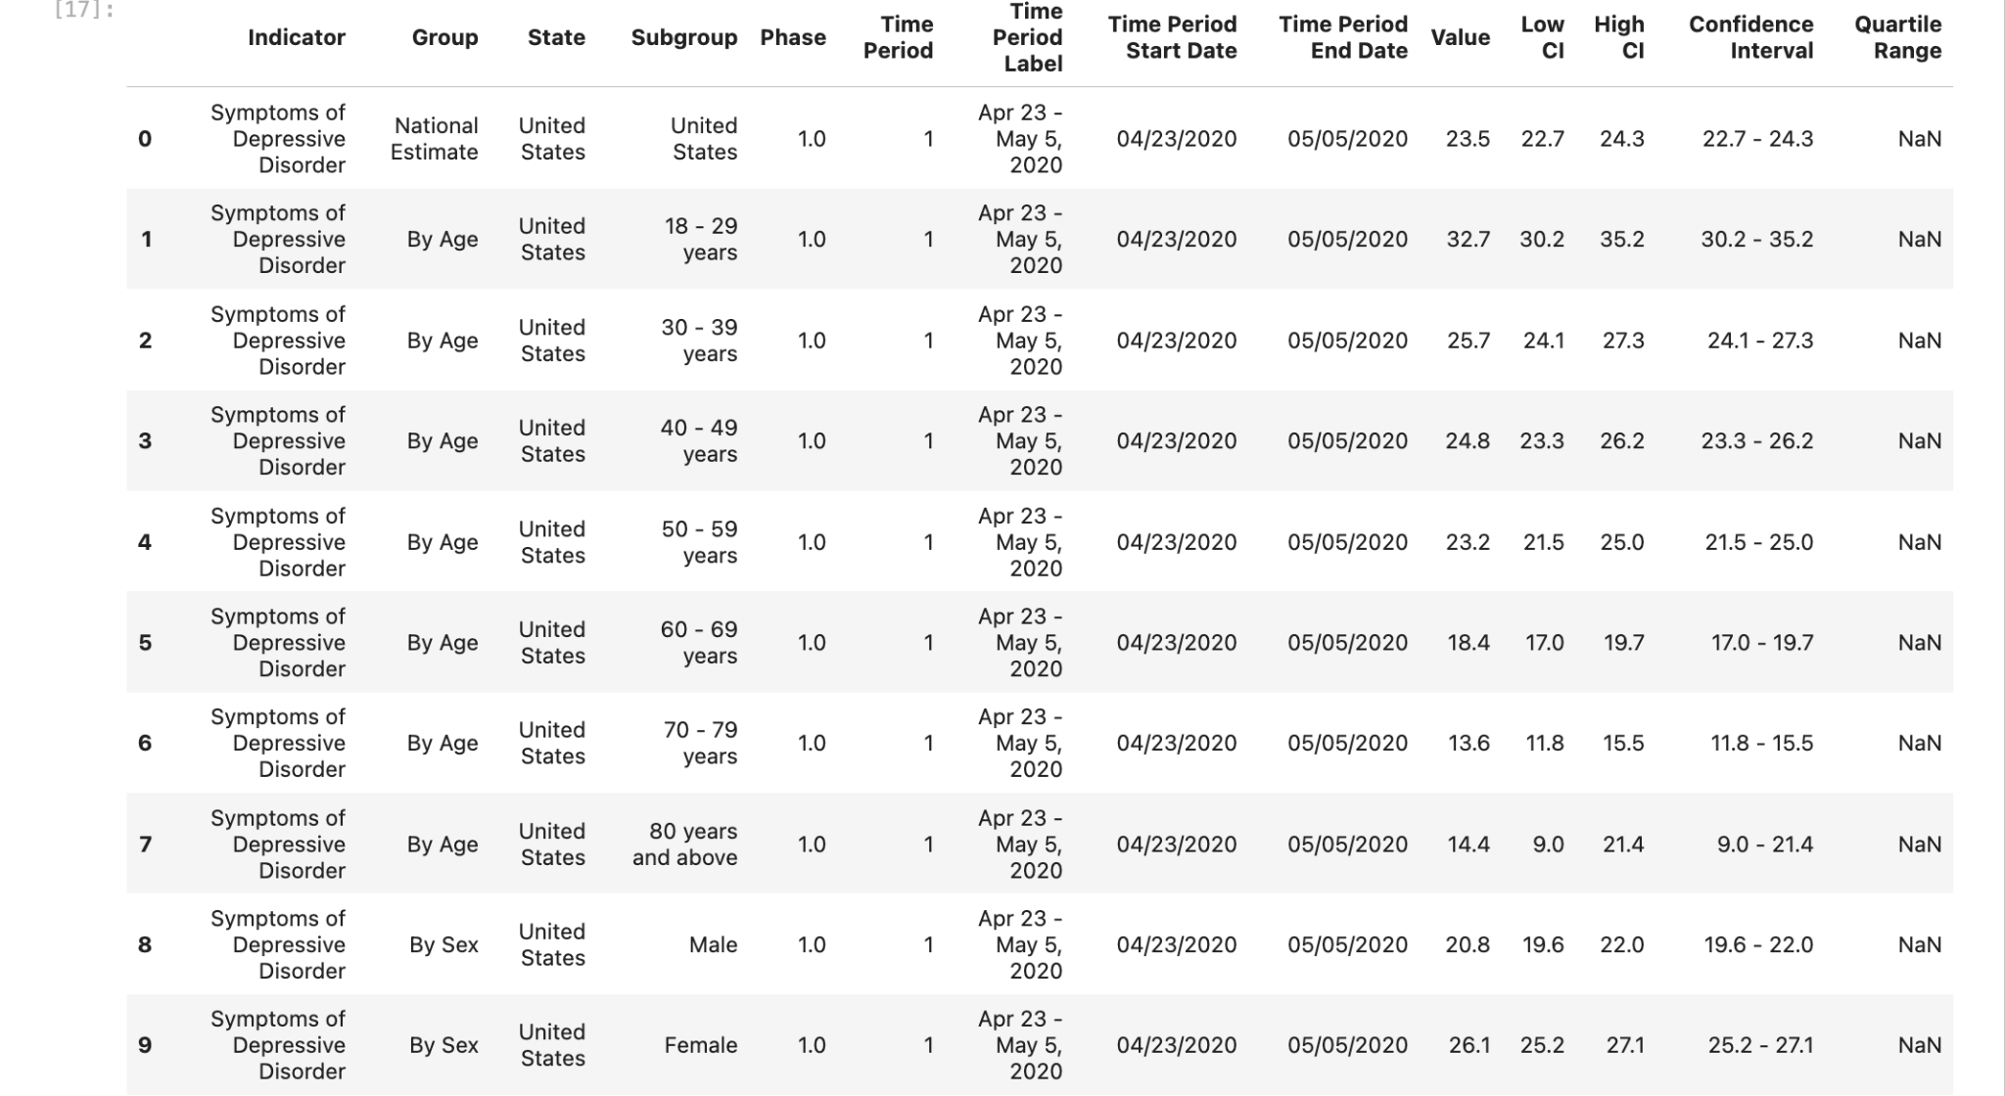
Exploring the data

Slide 5
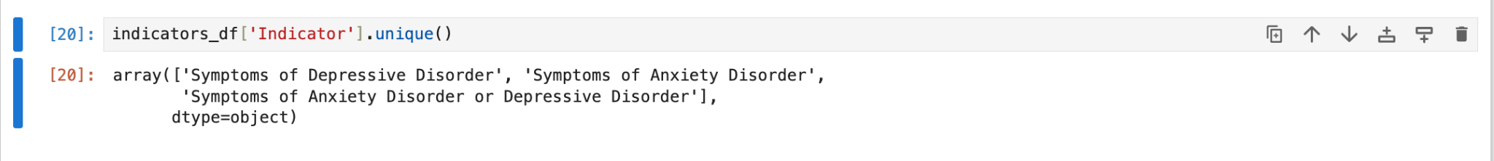
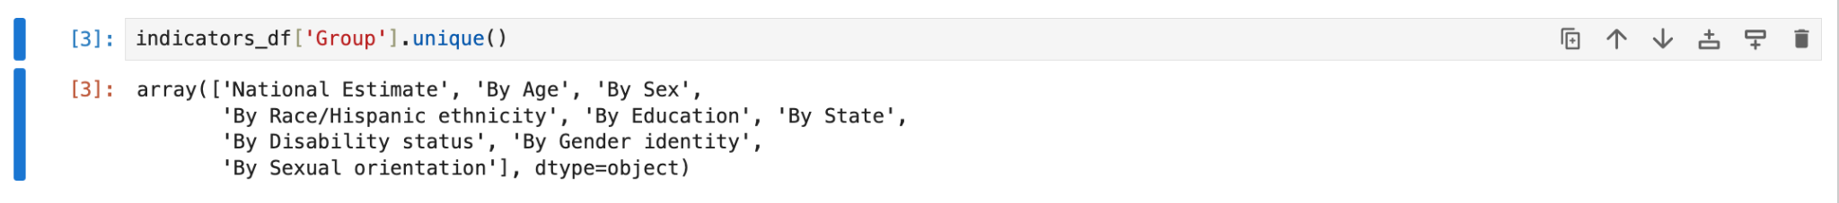
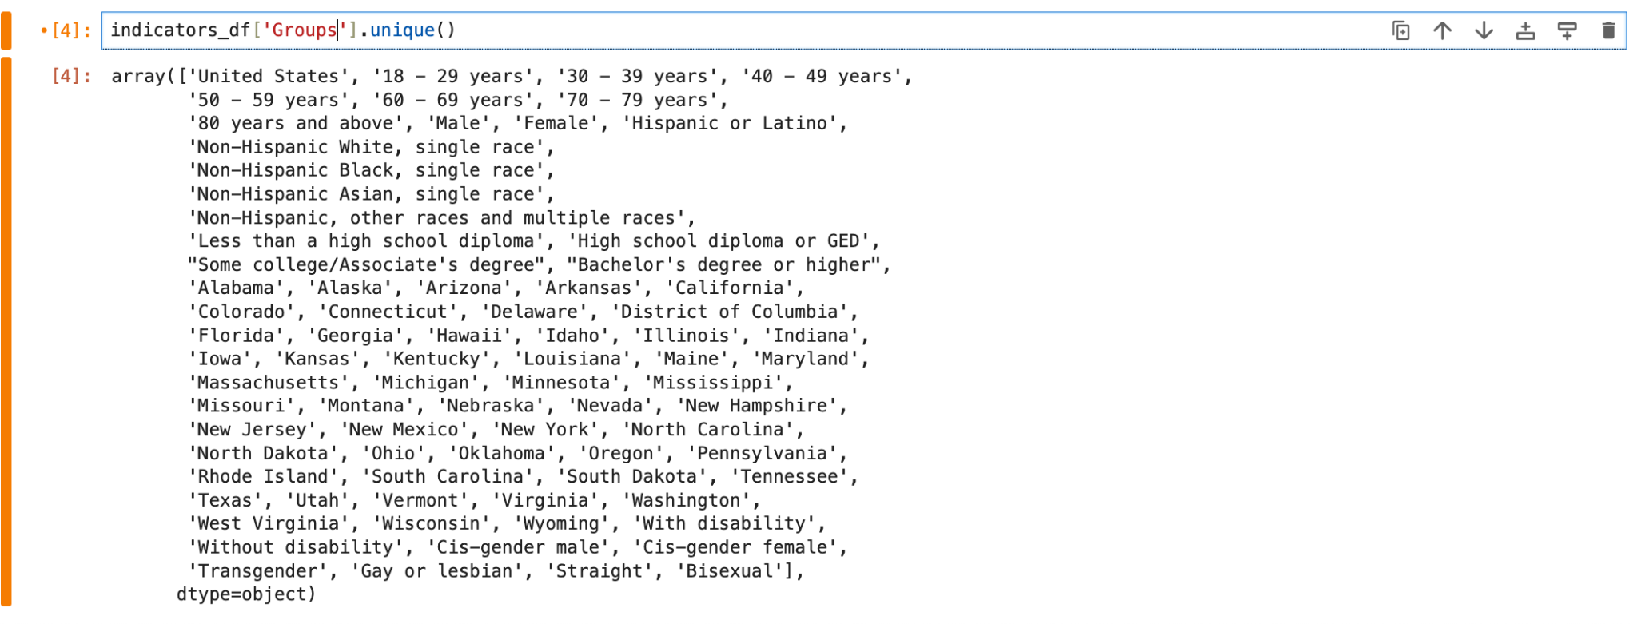

Slide 6
Guiding Questions
Is there a correlation between age and the frequency of symptoms experienced?
How does race/ethnicity factor into symptoms reported?
What does the data tell us about reported symptoms over state, sex, and education?

Slide 7
Data Exploration and Cleanup Process

Slide 8
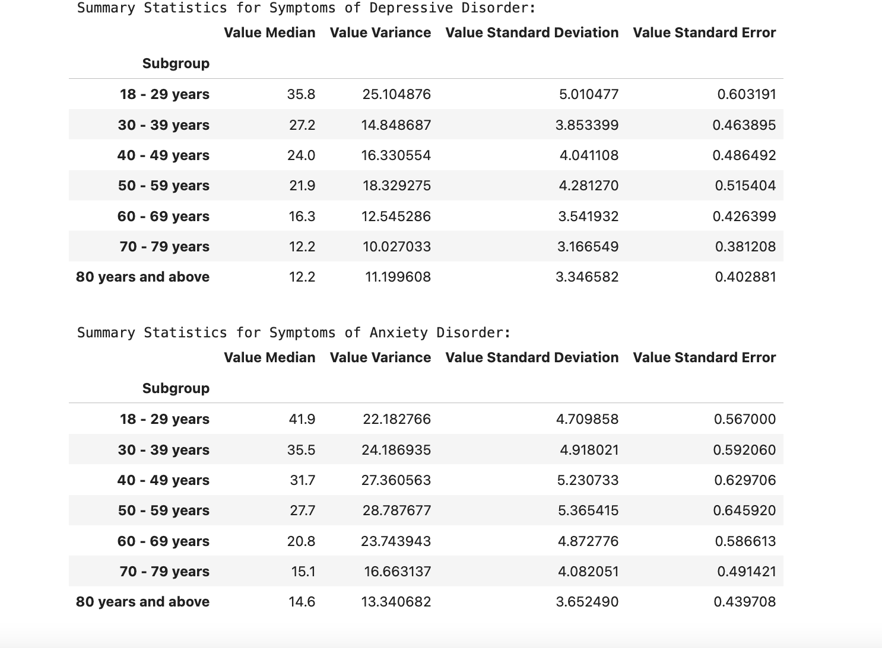
Cleanup
Leonardo
Created age_df
Created race_ethnicity_df
Summary statistics df for both by creating a function

Slide 9
Cleanup
Andrew
Checked structure of data using methods like .head() and .info()
Ensured that data in certain columns like “Value” were numeric so they could be used in calculations. If not, converted it using pd.to_numeric
Filtered the DataFrame to focus on specific indicators like depression, anxiety, and other relevant categories
Removed rows in the State column with the value “United States” with != ‘United States’
Grouped the data by certain columns and calculated the mean value for analysis
Used the cleaned and reformatted data to create visualizations

Slide 10
Data Conclusions By Questions

Slide 11
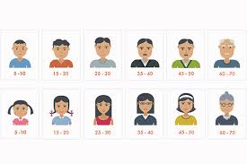
Is there a correlation between age and the frequency of symptoms experienced?

Slide 12
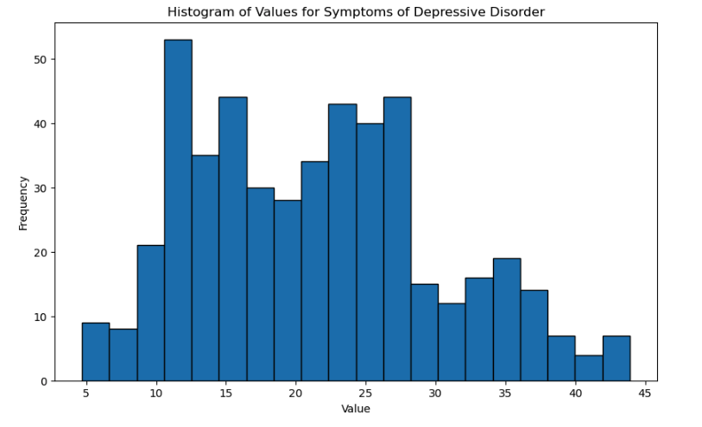

Slide 13
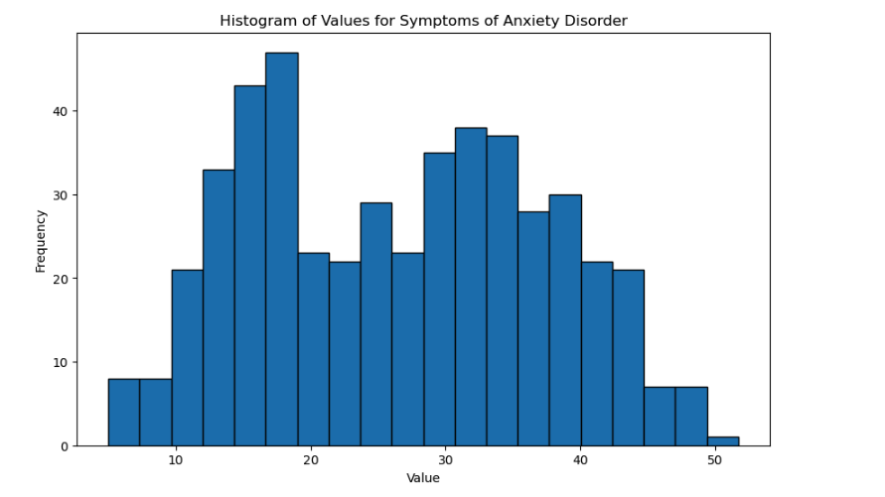

Slide 14
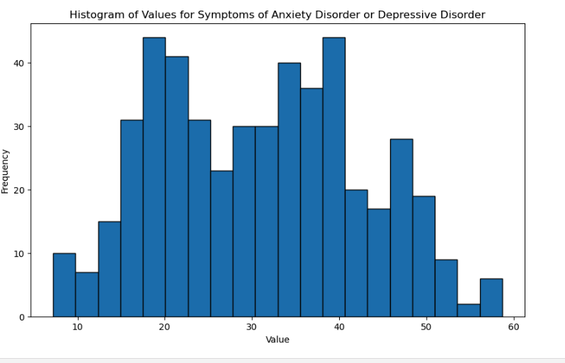

Slide 15
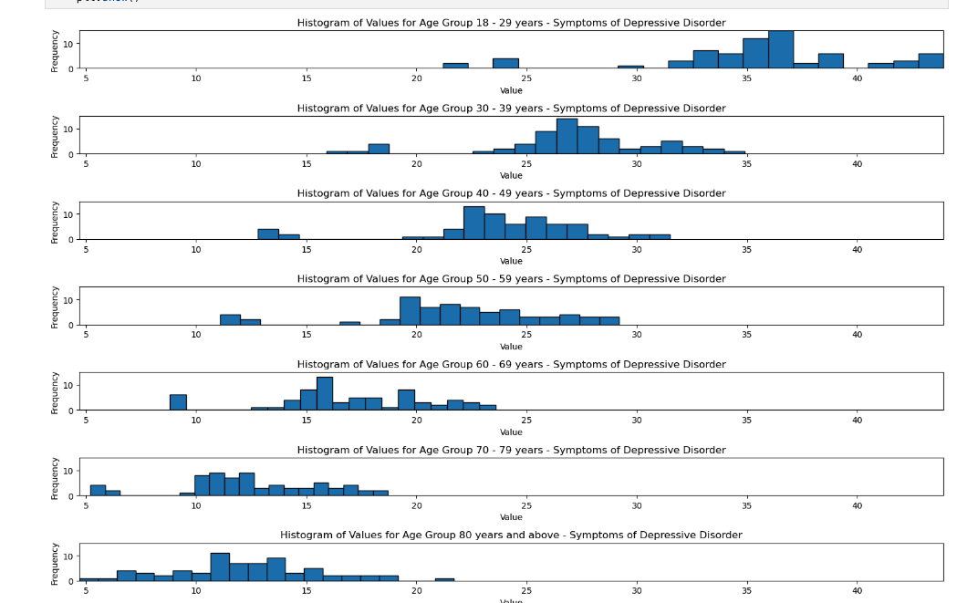

Slide 16
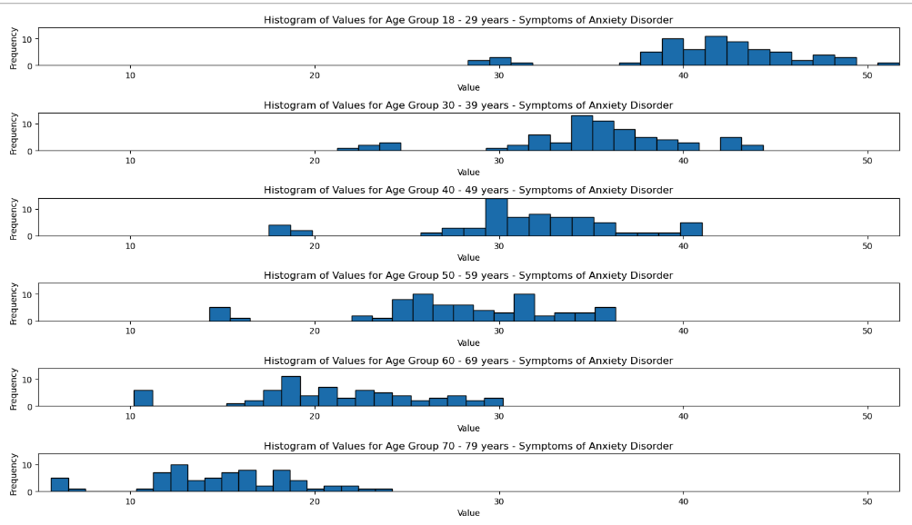

Slide 17
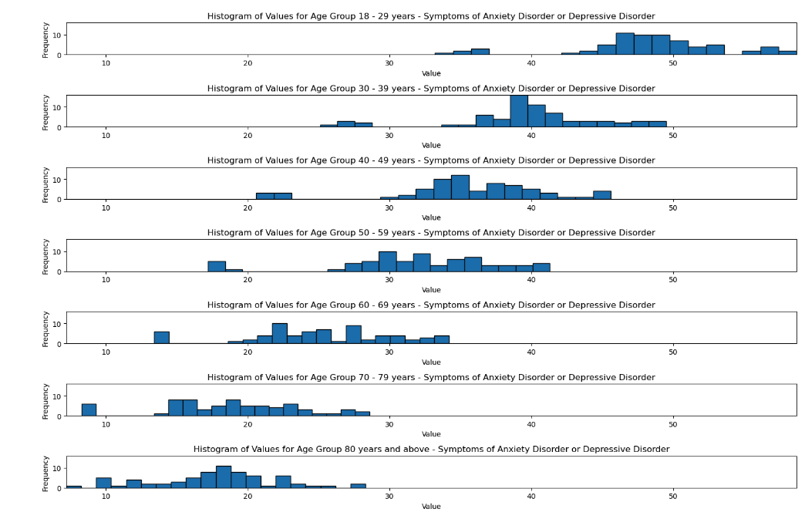

Slide 18
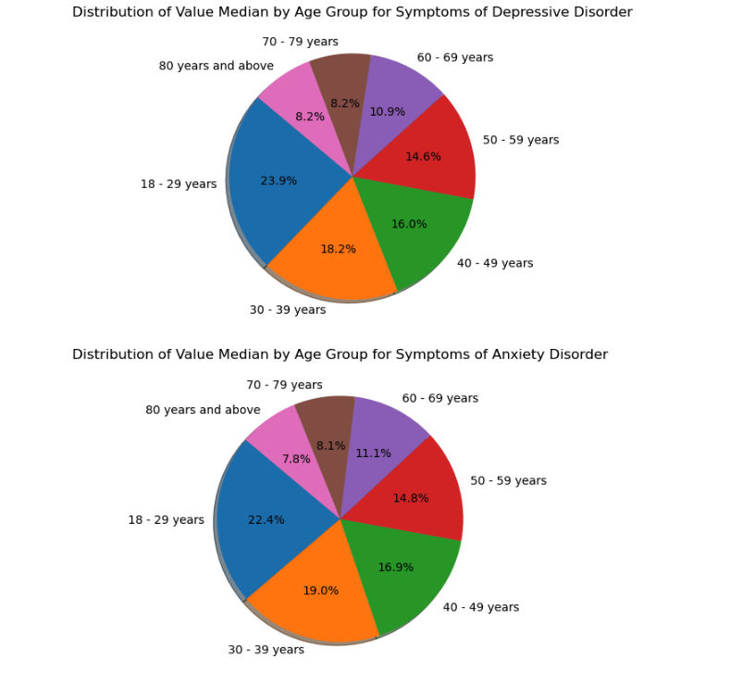

Slide 19
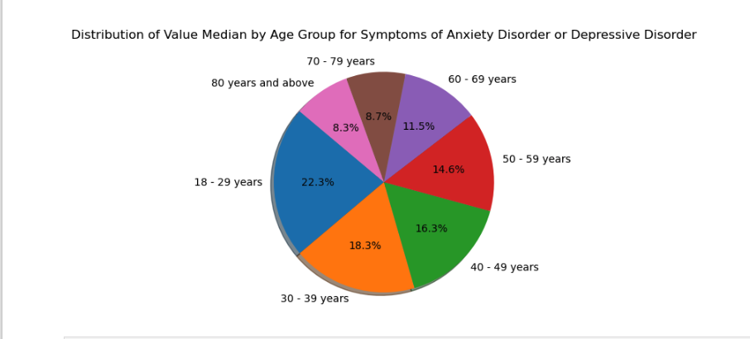

Slide 20
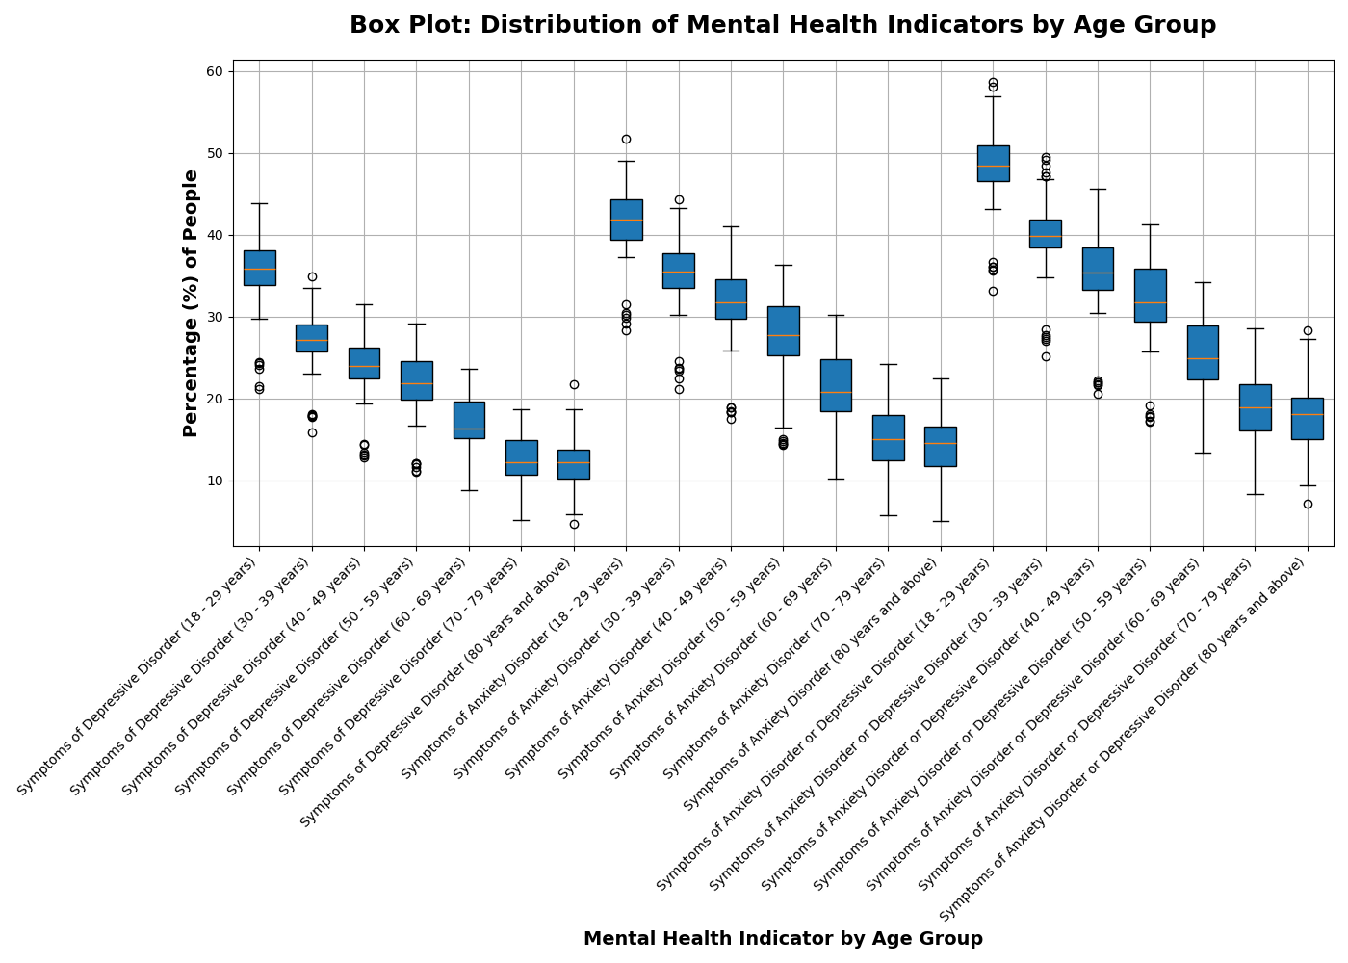

Slide 21
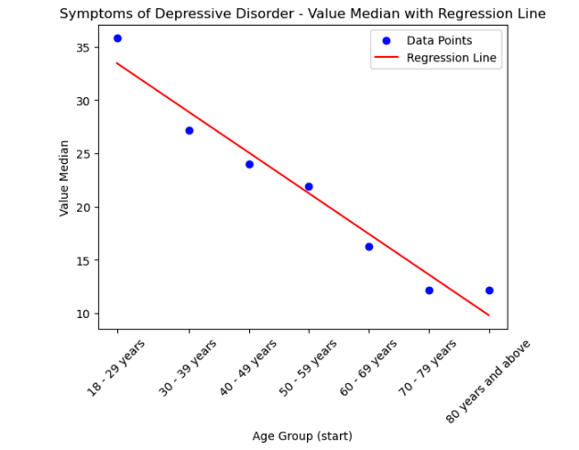

Slide 22
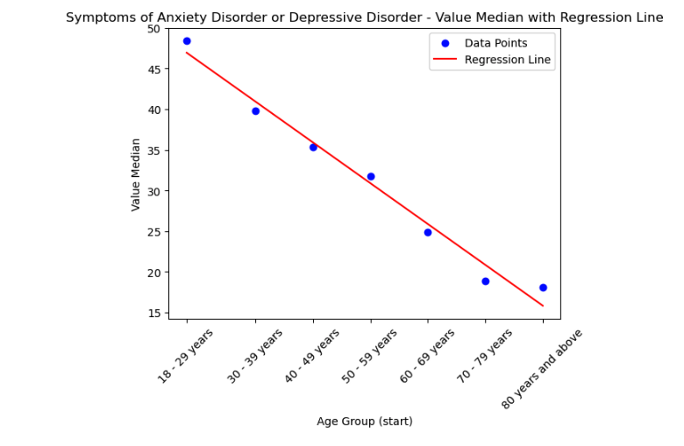

Slide 23
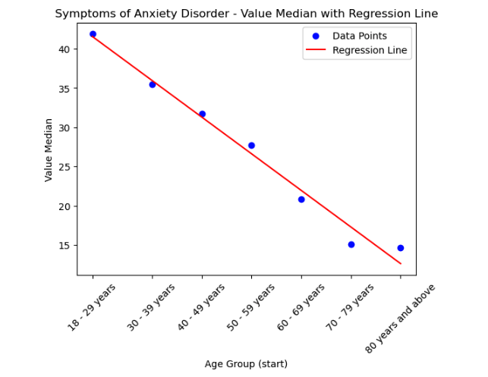

Slide 24

How does race/ethnicity factor into symptoms reported?

Slide 25
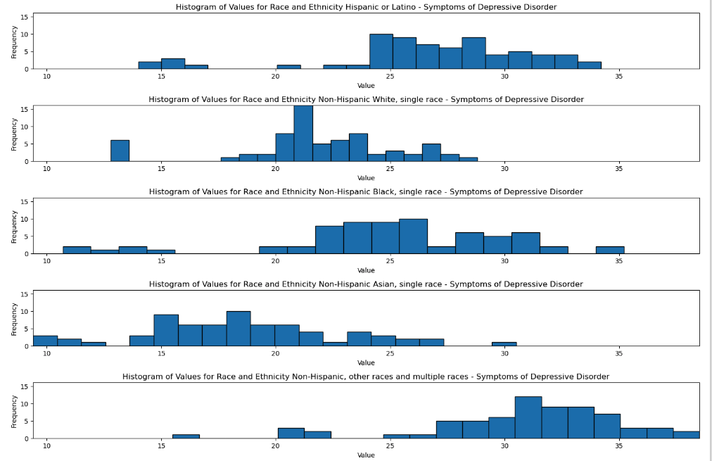

Slide 26
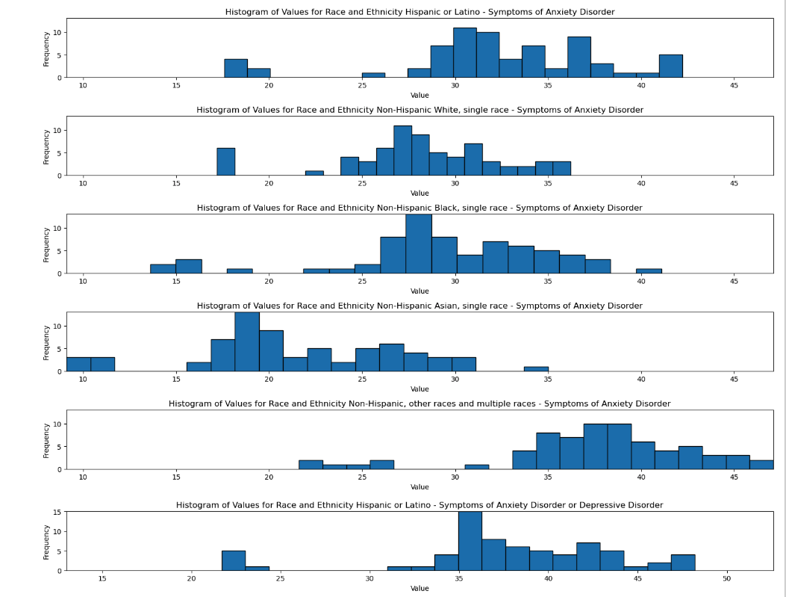

Slide 27
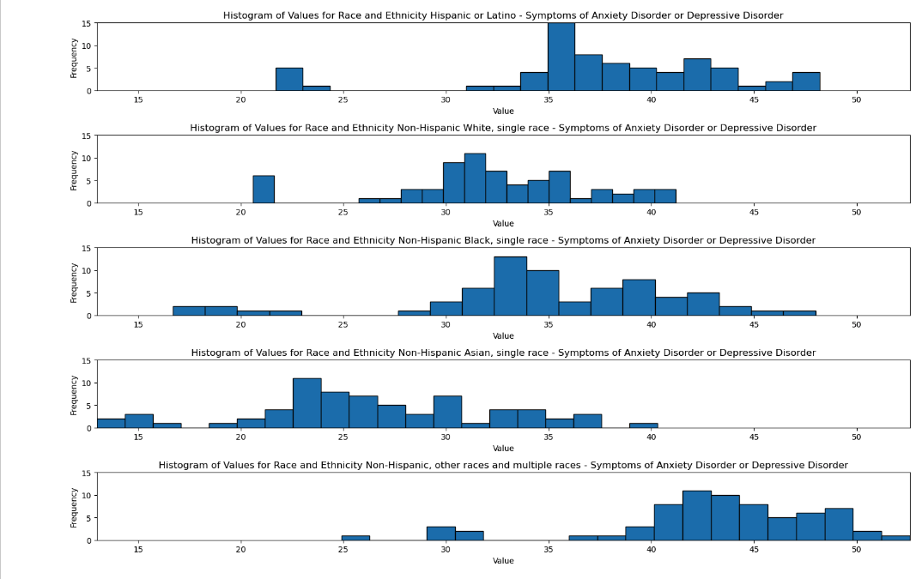

Slide 28
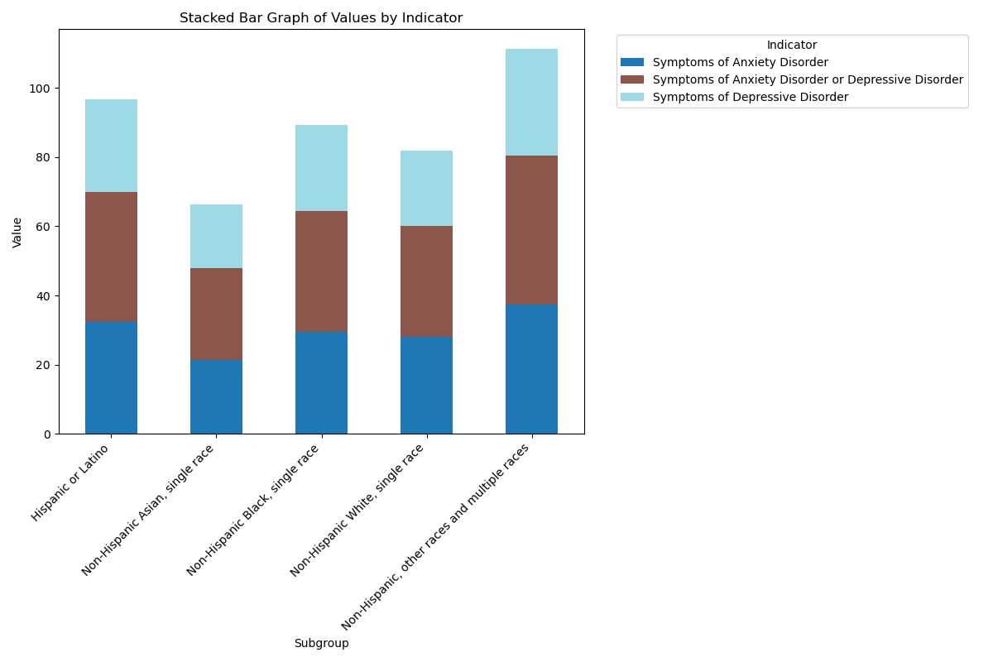

Slide 29


What does the data tell us about reported symptoms over state, sex, and education?

Slide 30
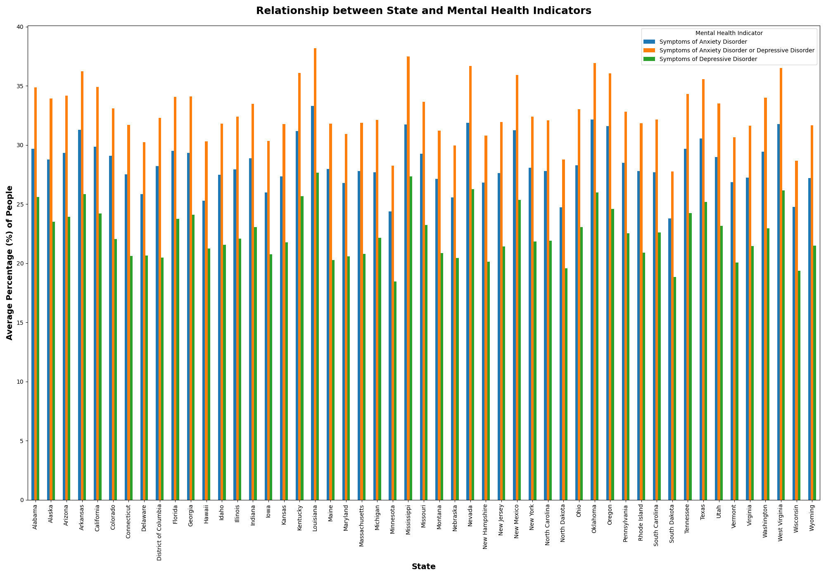

Slide 31
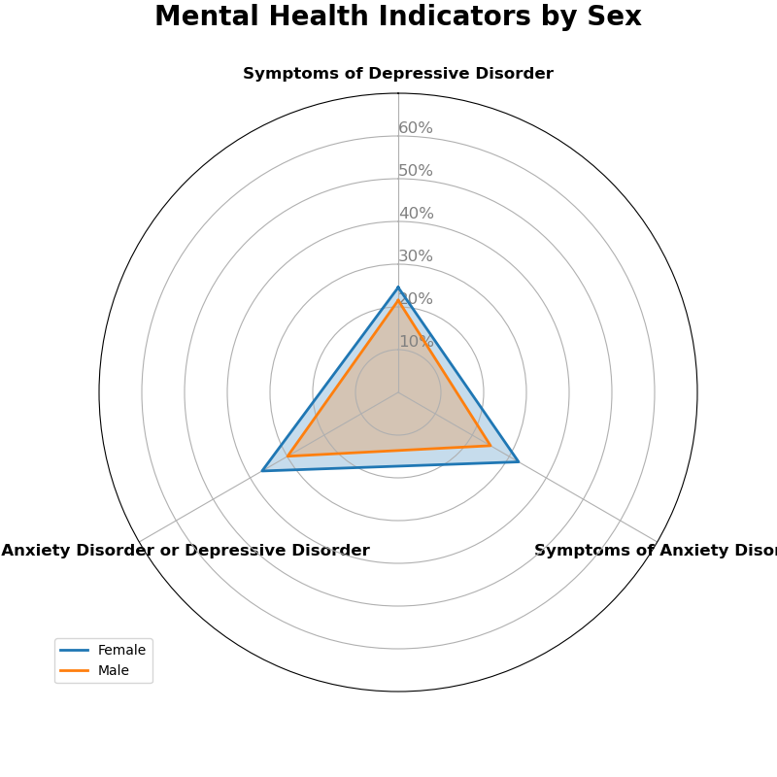

Slide 32
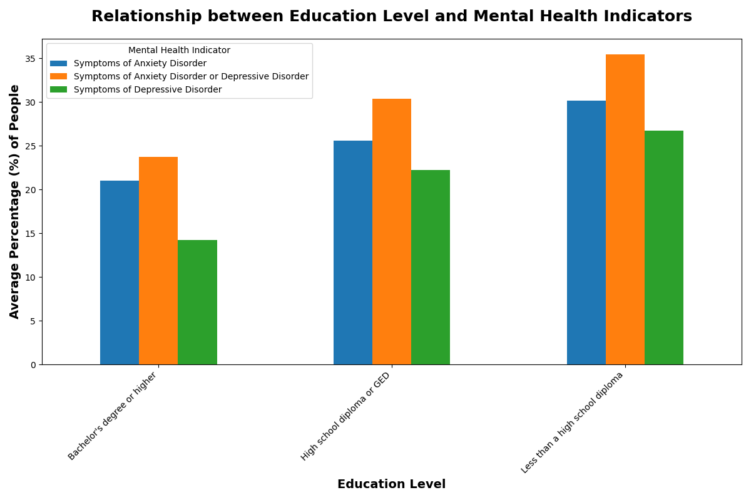

Slide 33
Making Sense of the Data

Slide 34
What does our data mean?
There is a correlation between age and reported symptoms
18-50 affected more significantly than older reporters
Races are affected differently
Asians reported less
Multi racial and latinos reported the most
Some states reported higher frequency of symptoms
Higher density states had higher reports in all indicators
Southern states report higher
Sexes may report at a different frequency
Men might not be as likely to report
Higher education leads to less reports

